Slide 1
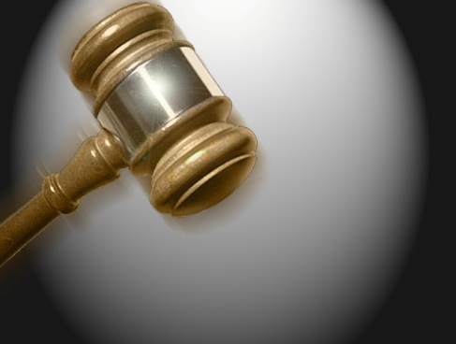
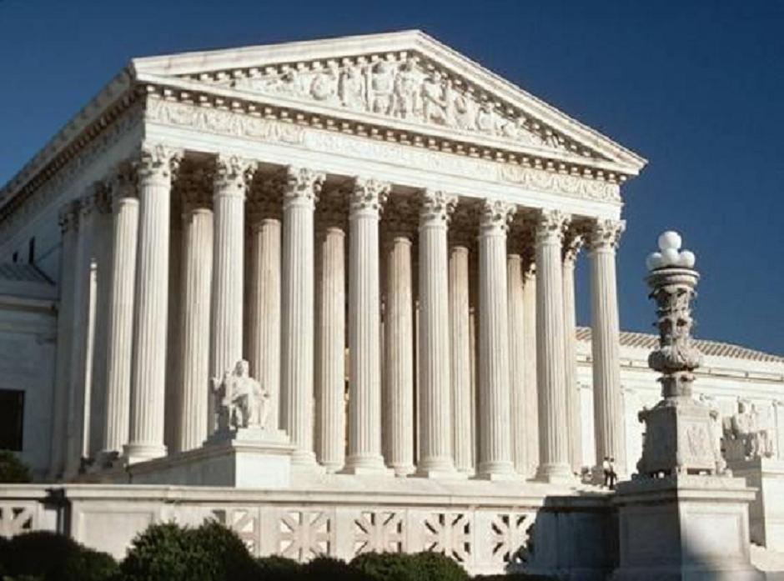
Visual Persuasion in a Litigation Trial:
The Case of Real Photographic Images vs. Sketched Images

Slide 2
Purpose of the Study
This study was designed to determine which kinds of graphic images were most useful as evidence in trials.
The reason for this study was to see if there is any difference in the jury’s decisions when using photographic images versus sketched images.
Will either type of graphic image help persuade a jury of a defendant’s guilt more than the other?

Slide 3
The Graphics Defined
Sketches involve pictures that are designed by computers, or hand drawn.
Photographs are created using a camera, which uses a lens to focus the scene's visible wavelengths of light, into a reproduction of what the human eye would see.
Types of graphics…

Slide 4
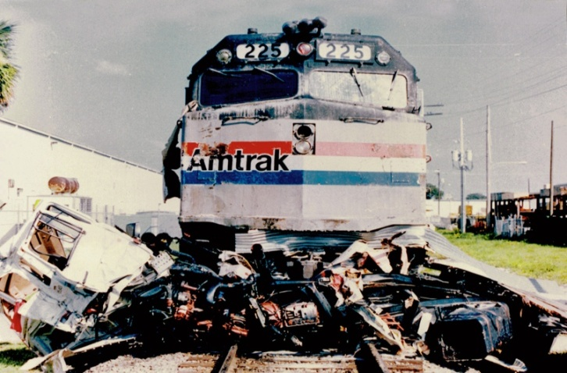
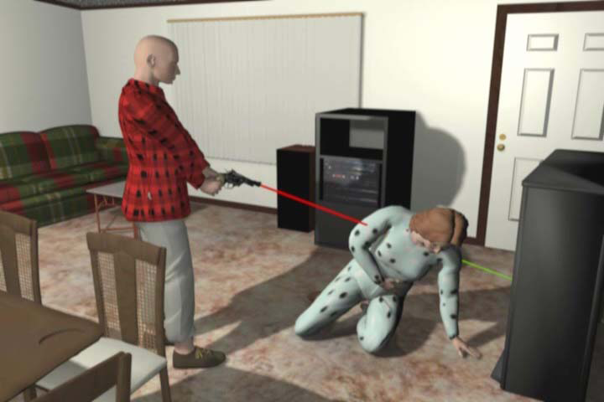
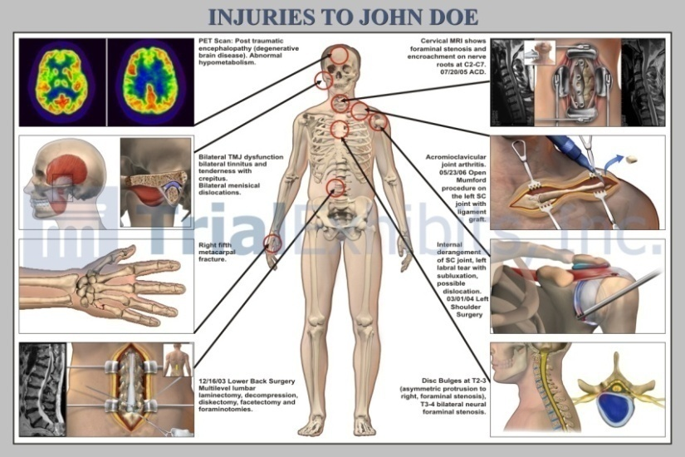
Examples of Graphics..
Photographs
Computer Made
Sketch
Diagrams

Slide 5
Background
Photographs
  The photograph in particular has long been perceived to have a special power of persuasion. (Mnookin, 1998).
  Seeing a photograph almost functions as a substitute for seeing the real thing. (Mnookin, 1998).
  Although a gruesome photograph may be relevant, a litigant may object to its admission as evidence because the litigant believes the photograph will be unfairly prejudicial. (Thomas, 1996).

Slide 6
Background
Photographs
  Forward-looking knowledge is the principal source of the photograph's power. (Friedman, 1995).
  Part of the power of these photographs, however much they may appeal to rather base voyeurism, lies in the their static quality -- in the scenes themselves, the moments they capture. (Friedman, 1995).

Slide 7
Background
It is a fundamental belief of many justice systems that jurors are impartial decision-makers, capable of rendering verdicts based solely on the evidence presented in a trial. (Boyll, 1991; Collins, 1997).
Even as judges insisted on their mere illustrative function, photographs often operated as independent, substantive proof of an especially persuasive kind. (Mnookin, 1998).
Photographs

Slide 8
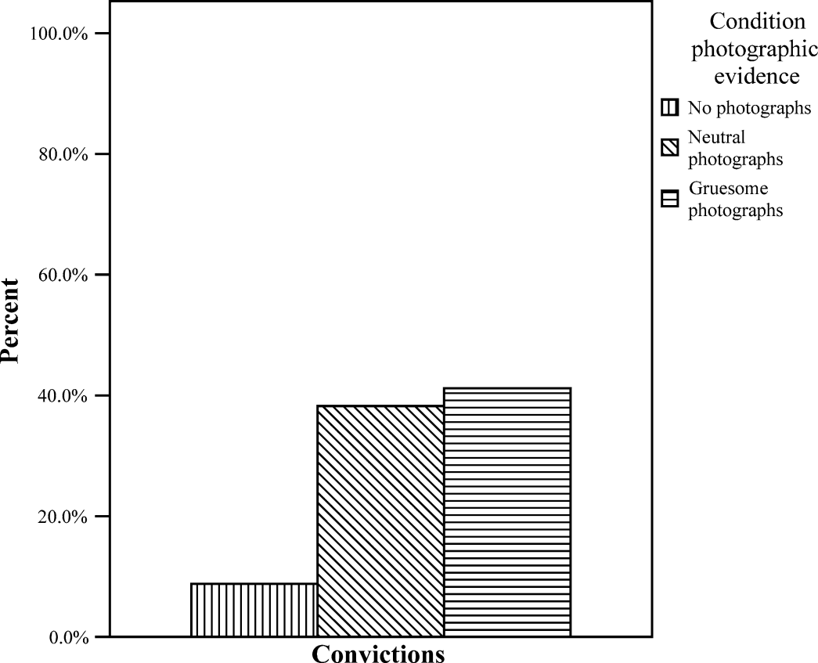
Background
Photographs
Results: Jurors that were
shown some sort of photo
showed higher conviction
rates than jurors that were
not shown a photo.

Slide 9
Background
Sketches
In State v. Harvey, the prosecution introduced "still animations" into evidence.
These still animations were graphic pictures drawn by a computer to illustrate the positions of the victim and the defendant.
The court found that the animations enhanced juror understanding and had strong probative value. (1996).

Slide 10
Background
Sketches
Computer graphics can transform complex fact patterns or technical data into comprehensible visual evidence.
They can illustrate important testimony, help to reveal subtle evidentiary relationships, examine alternate scenarios of an event or process without the expense and burdens of physical re-creation. (Krieger, 1992).

Slide 11
Background
Sketches
Computer reconstruction can help juries accurately gauge events and determine the appropriate weight to accord contrasting versions of events. (Fulcher, 1996).
Computer generated graphics enables lawyers to provide jurors with visual stimulation.
(Baer & Counts, 1998).

Slide 12
Background
Graphic images used as evidence can be a powerful and convincing tool, but it’s use can potentially create a risk of misleading or confusing the jury.
In addition, certain demonstrative evidence, such as gruesome photographs, may give rise to the danger of unfair prejudice. (Peterson, 2009).
Although courts in the US & Canada regularly admit graphic photographs into evidence, little research exists on whether such evidence prejudices the decisions of jurors. (Douglas, Lyon & Ogloff, 1997).
Persuasion of Jurors

Slide 13
Background
Using Photographic Evidence in Court
  When digital imaging is considered being used in a trial the concern of the admissibility of digital photographic evidence is often raised.
  Digital photographs are more easily altered than film-based photographs. (Roark, 2005).

Slide 14
Background
Using Photographic Evidence in Court
  Photos are admitted solely to illustrate the testimony of a witness and not as substantive evidence. (Peterson, 2009).
  In civil litigation, photographic images depicting the severity of an injury are submitted during a trial to purportedly help the jury assess economic (e.g. lost wages) and non-economic damages (e.g. physical pain). (Edelman, 2009).

Slide 15
Now Ask Yourselves…
Will a Photographic Image and a Computer Generated Sketch Have the Same Effect on Persuasion When Used at Trial in a Murder Case?

Slide 16
Our Hypotheses
#1
#2
Real photographic images of a scene will be more persuasive in jury trials than sketched images
Jurors will rate the defendant more guilty when looking at photographic images versus sketched images

Slide 17
Hypothesis #1
Real photographic images of a scene will be more persuasive in jury trials than sketched images.
  “When mock jurors that were read a transcript of a murder trial were also presented a picture of the murder victim, the proportion of guilty verdicts was doubled in the picture condition that in the no picture condition” (Douglas, 1997).

Slide 18
Hypothesis #1
Real photographic images of a scene will be more persuasive in jury trials than sketched images.
  There were few differences between groups as the extent to which participants felt that the photographs influenced their verdicts.
  (Douglas, 1997).
  Participants in all groups equally felt that they acted fairly. (Douglas, 1997).

Slide 19
Hypothesis #1
Real photographic images of a scene will be more persuasive in jury trials than sketched images.
  The mock juror felt anger towards the defendant in response to gruesome photographs they were shown.
  This enhanced the weight of inculpatory evidence in the jurors decisions.
  The presence of visual evidence (gruesome or neutral) significantly increased the conviction rate in this mock trial. (Bright & Goodman-Delahunty, 2005).

Slide 20
Hypothesis #1
Real photographic images of a scene will be more persuasive in jury trials than sketched images.
  Mock juror biases interacted with GEV (Graphic Evidence of Violence) to influence conviction thresholds.
(Oliver & Griffit, 1976; Whalen & Blanchard, 1982).
  Whereby the conviction thresholds of defense-biased mock jurors were higher in the presence of GEV.
(Oliver & Griffit, 1976; Whalen & Blanchard, 1982).

Slide 21
Hypothesis #2
Jurors will rate the defendant more guilty when looking at photographic images versus sketched images.
  “Further, these photographs, which are ostensibly provided to assist in the assessment of damages, actually strengthen a somewhat weak plaintiff case” (Edelman, 2009).
  “The results also suggest that plaintiff injury photographs have a significant, albeit proper, effect on non-economic damage awards.” (Edelman, 2009).

Slide 22
Hypothesis #2
Jurors will rate the defendant more guilty when looking at photographic images versus sketched images.
  A study conducted by Fishfader and colleagues (1996) indicated that GEV in the form of a videotaped crime reenactment did not influence mock jurors' liability judgments or damage awards.

Slide 23
Hypothesis #2
Jurors will rate the defendant more guilty when looking at photographic images versus sketched images.
  The “Danger of Unfair Prejudice” is explained in the Australian Law Reform Commission (1985) as follows;
  Thus, evidence (including photographs) that appeals to fact-finders’ sympathies, arouses a sense of horror, provokes an instinct to punish, or triggers other mainsprings of human action may cause the fact-finder to base his decision on something other than the established propositions of the case. (pp 351-352).

Slide 24
Procedure
Gave each participant the experiment packet
Told them to take their time to read the study and look at the graphic included
Asked to then carefully read and answer the questions at the end.

Slide 25
Methods: Design
Principal Actor
Real Sketched
Real
Context
Scene
Sketched

Slide 26
Methods: Subjects & Materials
Subjects
  40 CSU Chico Students
    Mean age 21.2
    Standard deviation- 1.34
  15 Males & 25 Females
  Conveniently Selected
Materials
  4 Page Mock Trial Story
  12 question survey about trial and picture
  Instruments: Photoshop, SSPS

Slide 27
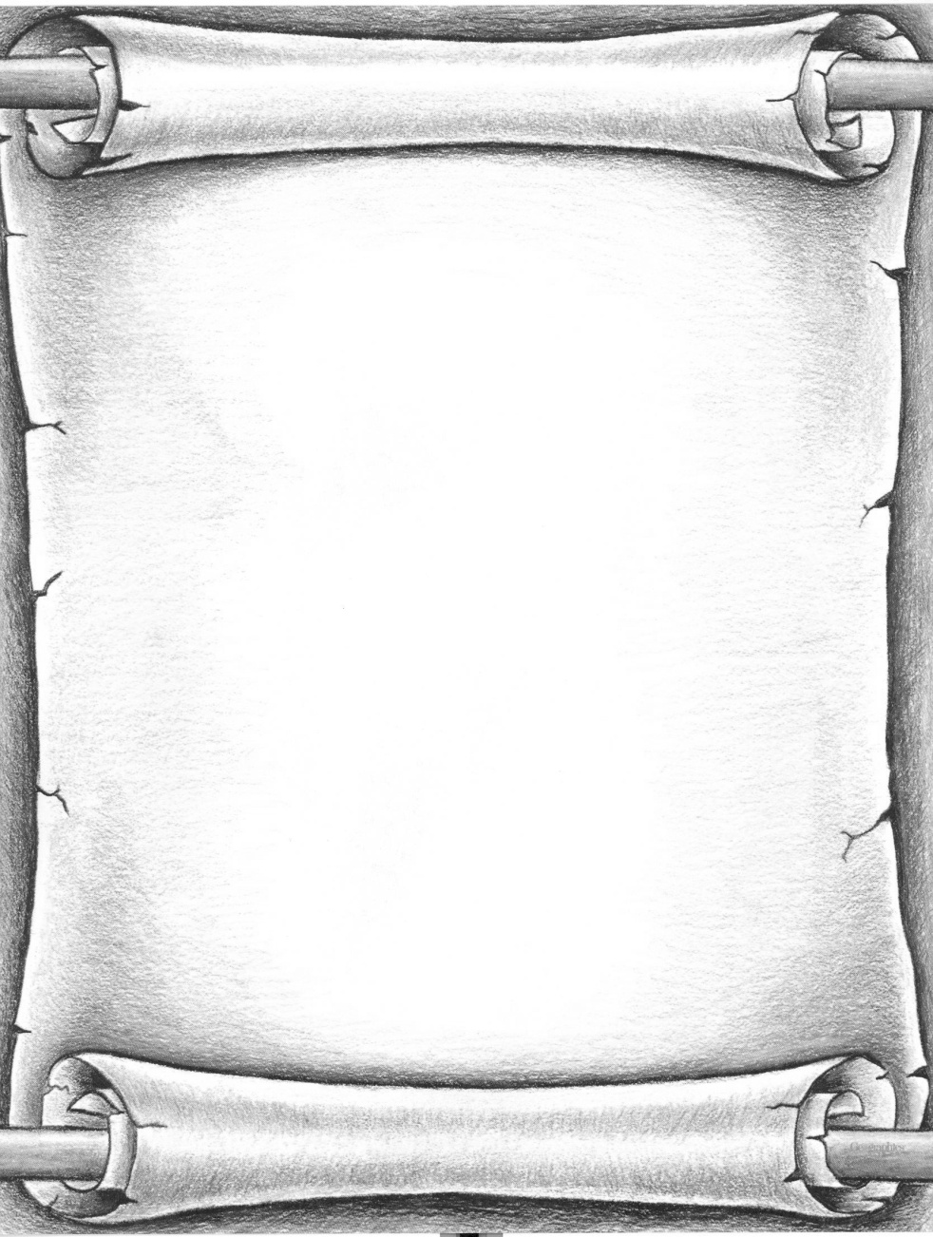
Methods: Materials
On September 29, 2002, petitioner Dwayne Marsh shot his ex girlfriend, Brenda Hill, inside the kitchen of his grandmother's house…
Mock Case:
On September 29, 2002, petitioner Dwayne Marsh shot his ex girlfriend, Brenda Hill, inside the kitchen of his grandmother's house. No witness saw the shooting, but Marsh's niece heard what transpired from outside the house. She heard Marsh and Hill speaking in loud argumentative tones. Hill then yelled “Granny, come in here” several times. Marsh's niece and grandmother looked inside and saw from a window that Marsh was standing with a gun, and holding it to Hill’s head [See Inserted Picture]. As Marsh’s niece and grandmother attempted to go around the yard and into the house they heard more yelling from Hill and Marsh. After what they estimated as 15-20 seconds, they ran into the house to see that Hill had been shot 2 times. One wound was consistent with Hill's holding her hand up at the time she was shot, and another was consistent with her having turned to her side. Marsh fled the scene after the shooting. He was apprehended by police approximately two weeks later and charged with murder.
Marsh's niece heard what transpired from outside the house. She heard Marsh and Hill speaking in loud argumentative tones….
Marsh's niece and grandmother looked inside and saw from a window that Marsh was standing with a gun, and holding it to Hill’s head…
After what they estimated as 15-20 seconds, they ran into the house to see that Hill had been shot 2 times. One wound was consistent with Hill's holding her hand up at the time she was shot, and another was consistent with her having turned to her side…

Slide 28

Methods: Materials
At trial, Marsh testified that he had acted in self defense. ..
He said that on the day of the shooting, Hill came to his grandmother's house and threatened to kill him and his new girlfriend, who had been at the house earlier. ..
Mock Story-Continued:
At trial, Marsh testified that he had acted in self defense. Marsh described Hill as jealous, and said he knew that she had once shot a man, that he had seen her threaten people with a knife, and that she had vandalized his home and car on prior occasions. He said that on the day of the shooting, Hill came to his grandmother's house and threatened to kill him and his new girlfriend, who had been at the house earlier. He said that Hill had also threatened to kill his new girlfriend when Marsh and Hill spoke on the phone earlier that day. Marsh testified that after Hill threatened him at the house, he went into the garage and retrieved a gun, took the safety off, and started walking toward the back door of the house. He said that Hill charged at him, and that he was afraid she had something in her hand. According to Marsh, he then lashed out after attempting to control Hill, the gun went off, but he did not intend to kill Hill.
Marsh testified that after Hill threatened him at the house, he went into the garage and retrieved a gun, took the safety off, and started walking toward the back door of the house. ..
He was afraid she had something in her hand. According to Marsh, he then lashed out after attempting to control Hill, the gun went off, but he did not intend to kill Hill…

Slide 29
Data Source
The following questions were selected because we felt that they were the most relevant to our hypothesis.
The questions were answered by marking down what score they felt was correct on a scale from 1 to 5 or a by answering yes or no.

Slide 30
Methods: Materials
Survey Questions:
1) Based on the information provided do you believe the defendant, Dwayne Marsh, intentionally caused harm to Stephanie Hill?
Yes No
2) How helpful was the recreation of the crime scene for you in terms of making a conviction or not?
(1 being least helpful, 5 being most helpful)
1 2 3 4 5
3) Based on the scene provided, when looking at it, how helpful is the scene in imagining the recreation of the crime?
(1 being least helpful, 5 being most helpful)
1 2 3 4 5
4) How guilty do you believe the defendant is?
(1 is least guilty, 5 is very guilty)
1 2 3 4 5

Slide 31
Methods: Design
Principal Actor
Real Sketched
Real
Context
Scene
Sketched

Slide 32
Methods: Materials
Experimental Pictures:
Real Actor/Real Context

Slide 33
Methods: Design
Principal Actor
Real Sketched
Real
Context
Scene
Sketched

Slide 34
Methods: Materials
Experimental Pictures:
Sketched Actor/ Real Context

Slide 35
Methods: Design
Principal Actor
Real Sketched
Real
Context
Scene
Sketched

Slide 36
Methods: Materials
Experimental Pictures:
Real Actor/ Sketched Context

Slide 37
Methods: Design
Principal Actor
Real Sketched
Real
Context
Scene
Sketched

Slide 38
Methods: Materials
Experimental Pictures:
Sketched Actor/ Sketched Context

Slide 39
The Results…

Slide 40
Results
Question 5-How helpful was the recreation of the crime scene in terms of making a conviction?
Participants that saw the Real Actor/Real Scene found the recreation more helpful than the other 3 groups
There was a significant main effect for the scene group

Slide 41
Question 5-How helpful was the recreation of the crime scene in terms of making a conviction?
Type of Graphic | Mean | Standard Deviation
Sketched Actor Sketched Scene | 2.7 | 1.42
Real Actor Real Scene | 4.2 | .79
Sketched Actor Real Scene | 3.2 | .79
Real Actor Sketched Scene | 2.5 | .85

Slide 42
Question 5 Graph
F(1,36) = 3.62, MS err=.99, p=.07

Slide 43

Question 5 Graph
F(1,36)= 12.17, MS err= .99, p=.01
Significant Main Effect

Slide 44
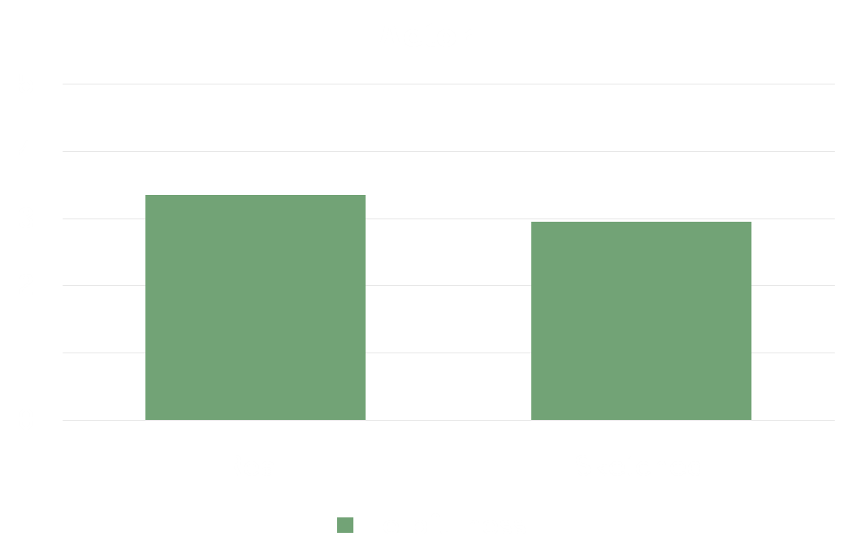
Question 5 Continued
F(1,36)= 1.61, MS err =.99, p=.22

Slide 45
Results
Question 9-How helpful is the scene in imagining the recreation of the crime?
Participants that saw the Real Actor/Real Scene found the graphic most helpful in imagining the actual crime scene.
There was a significant main effect for the scene group
There was a significant main effect for the actor group

Slide 46
Question 9-How helpful is the scene in imagining the recreation of the crime?
Type of Graphic | Mean | Standard Deviation
Sketched Actor Sketched Scene | 2.2 | 1.03
Real Actor Real Scene | 3.8 | .79
Sketched Actor Real Scene | 2.8 | 1.1
Real Actor Sketched Scene | 2.7 | 1.1

Slide 47
Question 9 Graph
F(1,36)=.610, MS err=1.03, p=.44

Slide 48

Question 9 Graph
F(1,36)=7.05, MS err=1.03, p=.01
Significant Main Effect

Slide 49

Question 9 Continued
F(1,36)= 5.49, MS err=1.03, p=.03
Significant Main Effect

Slide 50
Results
Question 12-How guilty do you believe the defendant is?
All groups rated the defendant very similarly in guilt, but the Real Actor/Real Scene was still the highest

Slide 51
Question 12-How guilty do you believe the defendant is?
Type of Graphic | Mean | Standard Deviation
Sketched Actor Sketched Scene | 4.0 | 1.2
Sketched Actor Real Scene | 3.8 | 1.0
Real Actor Real Scene | 4.4 | .7
Real Actor Sketched Scene | 4.0 | .81

Slide 52
Question 12 Graph
F(1,36)=1.013, MS err=.89,p=.321

Slide 53

Question 12 Graph
F(1,36)= .112, MS err=.89, p=.739

Slide 54

Question 12
F(1,36)= 1.01, MS err= .89, p=.321

Slide 55
Discussion
Findings:
Participants that viewed the Real Actor/Real Scene found the recreation most helpful for making a conviction.
Hypothesis 1:
Real photographic images of a scene will be more persuasive in jury trials than sketched images.
Findings:
Participants that viewed the Real Actor/Real Scene found the scene most helpful in imagining the crime scene.

Slide 56
Discussion
Hypothesis 1:
Real photographic images of a scene will be more persuasive in jury trials than sketched images.
Findings:
Participants that viewed the Fake Actor/Fake Scene found the scene least helpful in imagining the recreation of the crime scene

Slide 57
Discussion
Hypothesis 1 was supported
…that is, participants found a photograph to be more persuasive than a sketched image.

Slide 58
Discussion
Findings:
The Real Actor/Real Scene group found the defendant most guilty.
Hypothesis 2:
Jurors will rate the defendant more guilty when looking at photographic images versus sketched images.
Findings:
No group believed the defendant was not guilty.

Slide 59
Discussion
Hypothesis 2 was supported
…that is, participants found the defendant more guilty when they looked at a photograph rather than a sketched image.

Slide 60
Discussion
Interpretations
  Different cases might warrant different types of scenes- perhaps computer graphics would be more persuasive if the type of case different.
    Computer generated graphics enables lawyers to provide jurors with visual stimulation. (Baer & Counts, 1998).

Slide 61
Discussion
Interpretations
  Different cases might warrant different types of scenes- perhaps computer graphics would be more persuasive if the type of case different.
  Graphic images used as evidence can be a powerful and convincing tool, but it’s use can potentially create a risk of misleading or confusing the jury. (Peterson, 2008)

Slide 62
Discussion
Interpretations
Evidence (including photographs) that appeals to fact-finders’ sympathies, arouses a sense of horror, provokes an instinct to punish, or triggers other mainsprings of human action may cause the fact-finder to base his decision on something other than the established propositions of the case
  Perhaps jurors found the defendant was guilty because the case evoked emotion, and not because the evidence was strong.

Slide 63
Discussion
Interpretations
  Groups that saw the Real Actor/Sketched Scene and Sketched Scene/Real Actor both had similar results, and perhaps found the scene to just look odd and not useful.
Although regularly admit graphic photographs into evidence, little research exists on whether such evidence prejudices the decisions of jurors. (Douglas, Lyon & Ogloff, 1997).

Slide 64
Conclusion
Limitations
  Small sample size
  No control group- if we had control group we could have seen the results if there was no picture at all
  Convenient Sampling

Slide 65
Conclusion
Graphics should be used to carefully convey what the facts of the case are.
Further research should look at whether or not photos or computer graphics are more useful for the specific type of case (ex: murder trial versus civil litigation)
Photographic images are most useful

Slide 66
Conclusion
Images are useful for persuasion, but the facts of the case are most important.
More research should be conducted on how specific graphics effect specific trials.

Slide 67
References
Edelman, Bryan. (2009) The Jury Expert, The Art and Science of Litigation Advocacy.
Peterson, Kathleen Flynn. (2009) The Advocate, Enhanced persuasion: Effective use of Demonstrative Evidence at Trial.
Friedman, Richard. (1995) Still Photographs in the Flow of Time.
Mnookin, Jennifer L. (1998) The Image of Truth: Photographic Evidence and the Power of Analogy.
Guilshan, Christine A. (1992).The influence of judicial instructions and the effect of juror biases.

Slide 68
References
Thomas, Amy S. Utah Rule of Evidence 403 and Gruesome Photographs: Is a Picture Worth Anything in Utah.
State Vs. Harvey. (1996) JURY AS WITNESS: FORENSIC COMPUTER ANIMATION TRANSPORTS JURORS TO THE SCENE OF A CRIME OR AUTOMOBILE ACCIDENT.
Douglas. (1997) The Impact of Graphic Photographic Evidence on Mock Jurors' Decisions in a Murder Trial.

Slide 69
References
Goodman- Delahunty, Jane. (2005) Mock juror anger at the defendant in response to gruesome photographs enhanced the weight of inculpatory evidence in jury decisions. The presence of visual evidence (gruesome or neutral) significantly increased the conviction rate in a mock juror study.
Thompson, Carleen M.; Dennison, Susan. (2004) Graphic evidence of violence: the impact on juror decision-making, the influence of judicial instructions and the effect of juror biases.

